Slide 1
The Future of School Districts is Superior Customer Service
A conversation with Atlanta Public Schools (APS)

Slide 2
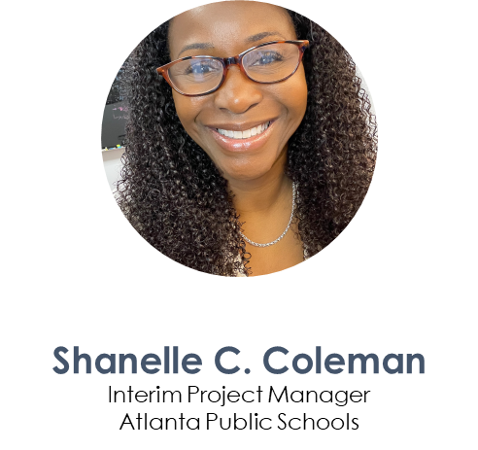
Michael D. Wilburn, Jr. Coordinator of Special Projects Atlanta Public Schools

Slide 3
About Atlanta Public Schools
52,000+
Students
91+
Schools + Programs
6,000+
Employees
Notes:
WHAT IS THE TOTAL # OF EMPLOYEES AT APS? PLEASE CONFIRM THE HIGHLIGTED NUMBERS

Slide 4
What is Superior Customer Service at APS?

Slide 5
Superior Customer Service is
“The Customer Service Experience”
The ATLANTA PUBLIC SCHOOLS customer service experience is designed to provide superior customer service for all stakeholders in Atlanta Public Schools.
Our mission is to raise expectations and increase satisfaction for every stakeholder who contacts an employee in any APS school or department.

Slide 6
The APS Customer Service Experience
Define
customer service expectations and standards
Customer
Service
Experience
Communicate the benefits of superior service
Set and monitor customer service goals
Outline everyone’s role in customer service
Create a focus on the APS customer experience and standards

Slide 7
APS Customer Service Experience includes:
Building capacity of all APS employees on the expectations and standards for customer service
Provide a tool to capture questions, feedback, complaints, and compliments that are measurable.
Communicate with stakeholders on how to utilize the customer service platform

Slide 8
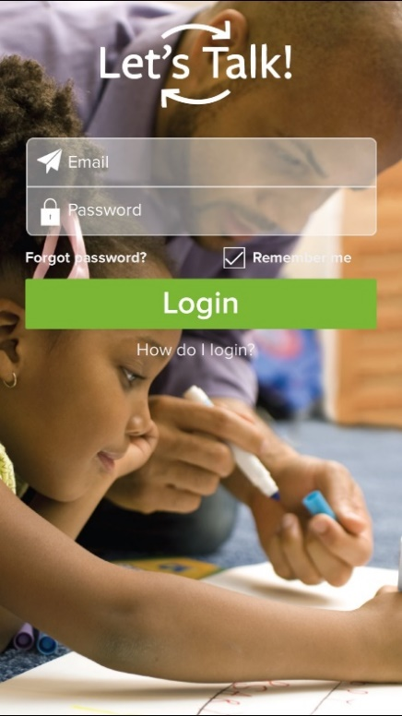
APS and Let’s Talk!
In 2019, APS implemented Let’s Talk! to innovate customer service by evolving the way we engage through technology, timeliness, and ongoing service training.
Notes:
Updated – OA

Slide 9
What is Let’s Talk?
The only all-in-one, enterprise-wide customer experience and intelligence platform purpose-built for education
Notes:
Updated – OA

Slide 10
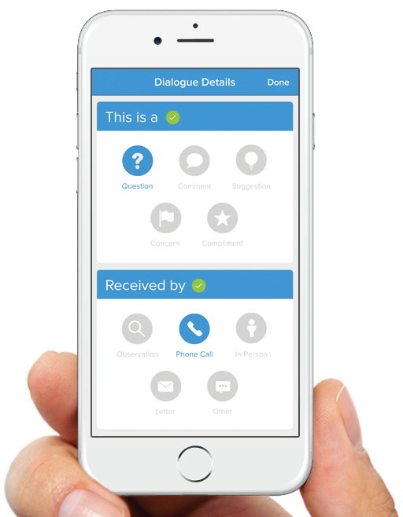
APS Let’s Talk! Goals:
Collaboration
Cross department/school site collaboration
Connect
Simplify the process for the Board of Education (BOE) to connect stakeholders to administration to solve problems
Consistency
Create consistency in expectations around responsiveness across departments/schools
Process
Develop protocols and consistent processes to ensure a positive customer experience
Listen. Learn. Lead.

Slide 11
Why Let’s Talk
SUPPORTS DISTRICTS WITH A FOCUS ON THE CUSTOMER EXPERIENCE…
BUILD STRONG RELATIONSHIPS
WITH THEIR STAKEHOLDERS
(EXTERNAL & INTERNAL)
STREAMLINE THEIR PROCESSES SO THAT THEY CAN FOCUS MORE ENERGY ON IMPROVING STUDENT SUCCESS
MAKE INFORMED DECISIONS THAT ARE DATA-DRIVEN (AND VALUES-DRIVEN)
Notes:
Updated this slide (OA)

Slide 12
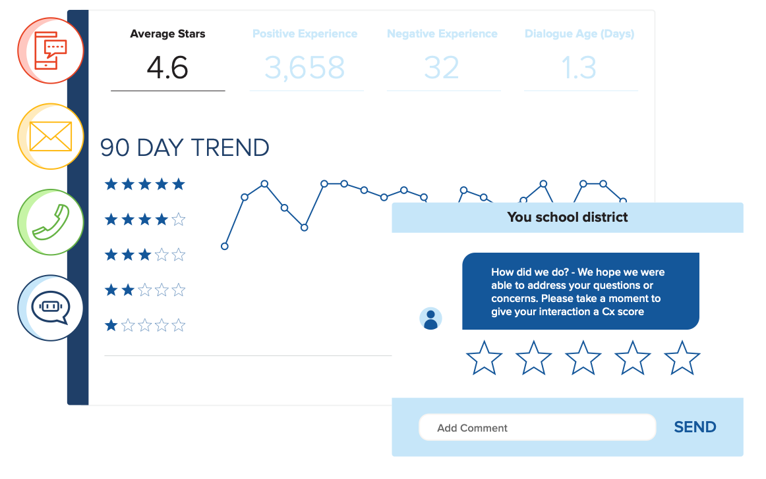
Unified Inbox. Unified Community.
Let’s Talk! helps Atlanta Public Schools:
Automate and simplify internal and external communications
Identify problems before they become crises
Improve equity and access
Build community trust and support
Instantly connect our educational community to APS decision-makers
Keep connectivity and accountability in one location that other forms of communication do not allow (i.e., phone, email, online submissions, and/or social media)
Notes:
I made some slight copy edits to this slide (OA)

Slide 13
The Customer Service Experience delivered…
“I have been really impressed with how communicative the district has been as they navigate this very sensitive subject. Thank you for listening and responding.”
Parent/Guardian, CX Score 10
“Thank you for a quick transparent response.”
Parent/Guardian, CX Score 10
“This was a pretty easy process and, when reached out to, my concerns were addressed swiftly.”
Parent/Guardian, CX Score 10

Slide 14
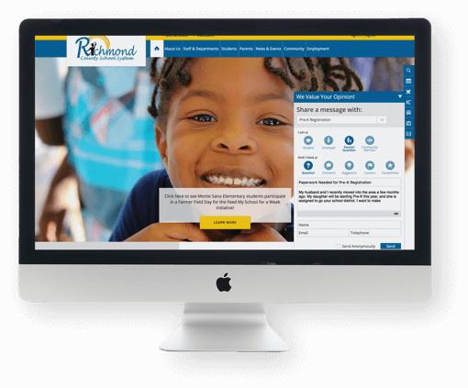
Reporting & Monitoring
Measurement and Evaluation

Slide 15
District Overview
TOTAL DIALOGUES: 5,333
FY 2021-22 TOTALS
Unopened: 64 Open: 69 Unresolved Critical: 0
CX SCORE
6.8 | SLIPPING; Check overall dialogue age and drill down in comparison report.
DIALOGUE AGE
4.4 | GETTING BETTER; Monitor interest areas in comparison report.
PAST DUE
27 | IMMEDIATE ATTENTION IS NEEDED; Check past due dialogues.
UNRESOLVED CRITICAL ALERTS
0 | LOOKING GOOD; Currently, there are no critical dialogues.
483 | Positive Experiences
275 | Negative Experiences

Slide 16
Cx stands for Customer Experience. The Cx Score (measured on a 10-point scale) is the average score calculated by adding all feedback scores received during the selected time period and dividing
CX Score Trend
Current Average: 6.8
FY 2021-22
798 Feedback Forms Received

Slide 17
Total number of feedback forms received by Cx Score
CX Score Distribution
FY 2021-22
798 Feedback Forms Received

Slide 18
The most popular Interest Areas in the current fiscal year
Top Interest Areas
FY 2021-22

Slide 19
Dialogues Tags are similar to labels in email platforms; users have the ability to add Tags to their dialogues.
Top Dialogue Tags
FY 2021-22

Slide 20
?
THANK YOU!

